Slide 1
Project 1.3: Analyzing the Protein Coding Mutations in the Zimmerome
Ramya Prathuri, Megan Brady, and Nir Neumark

Slide 2
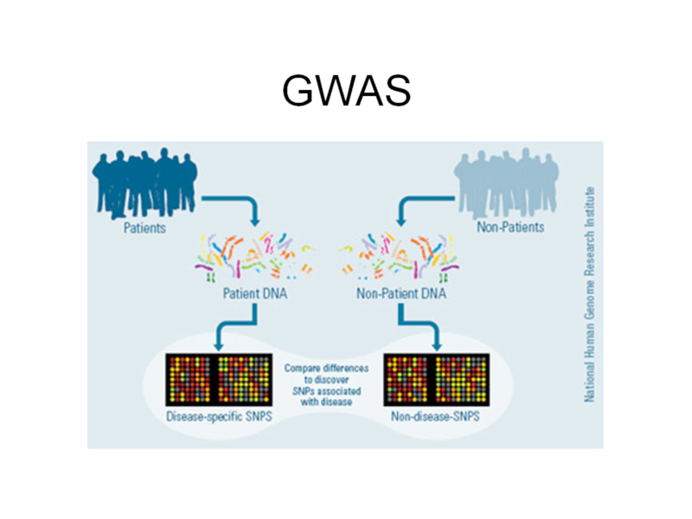
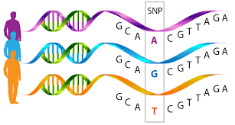
What is Variant Prioritization?
The process of identifying deleterious SNVs
SNP = seen in > 1% population
SNV = no limitation on frequency
Notes:
https://www.addgene.org/crispr/guide/
https://3dciencia.wordpress.com/2015/06/11/the-cas9-sgrna-dna-complex/

Slide 3
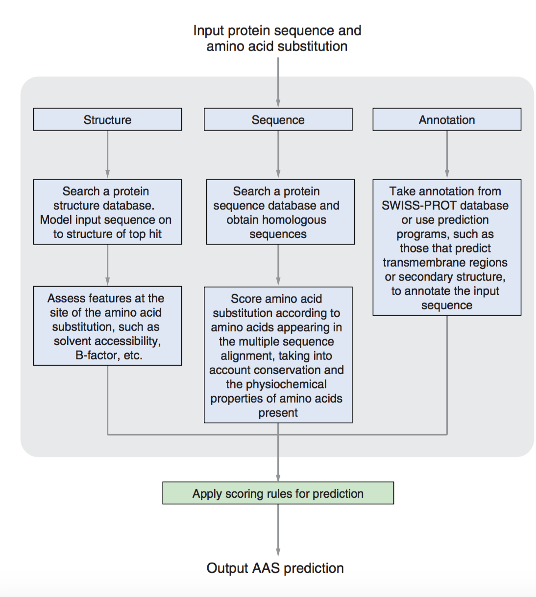
Principles of Variant Prioritization
Sequence:
synonymous or not?
missense or nonsense?
aa charge? size?
Structure:
Phyre2, TMHMM
Annotation:
dsSNP? GO term?
Notes:
https://www.addgene.org/crispr/guide/
https://3dciencia.wordpress.com/2015/06/11/the-cas9-sgrna-dna-complex/
https://www.idtdna.com/pages/docs/default-source/synthetic-biology/crispr_faq_043015.pdf?sfvrsn=2

Slide 4
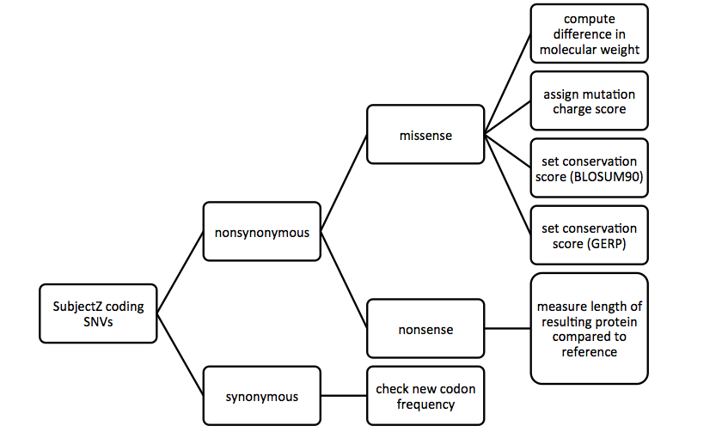
Goal: How to prioritize variants?
Consider a variety of parameters to assess SNVs

Slide 5
Mutation features
Location
Charge Change
Size Difference
Substitute
Blosum
PAM
GERD

Slide 6
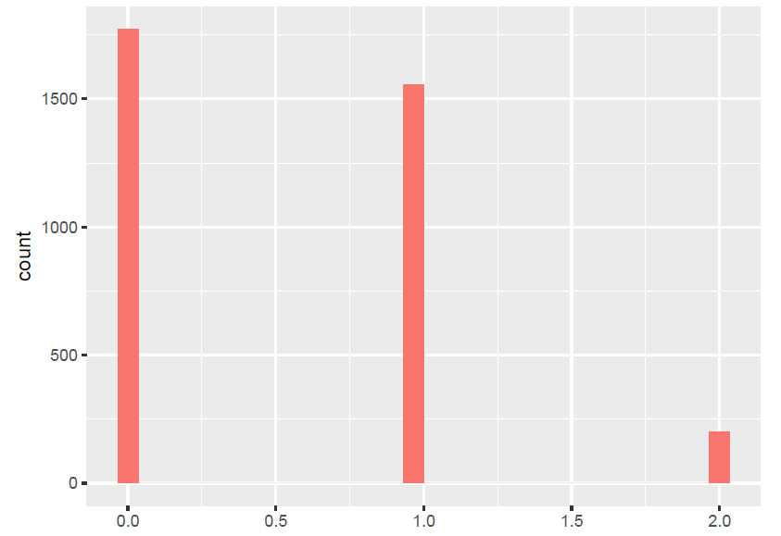
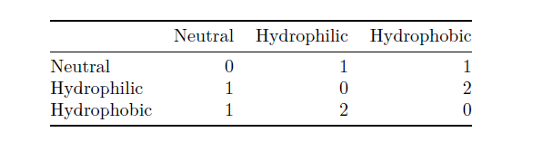
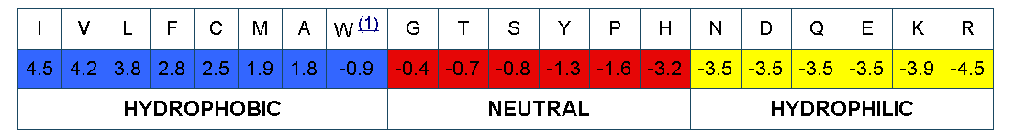
Charge Change
Adapted from: http://www.imgt.org/IMGTeducation/Aide-memoire/_UK/aminoacids/IMGTclasses.html

Slide 7
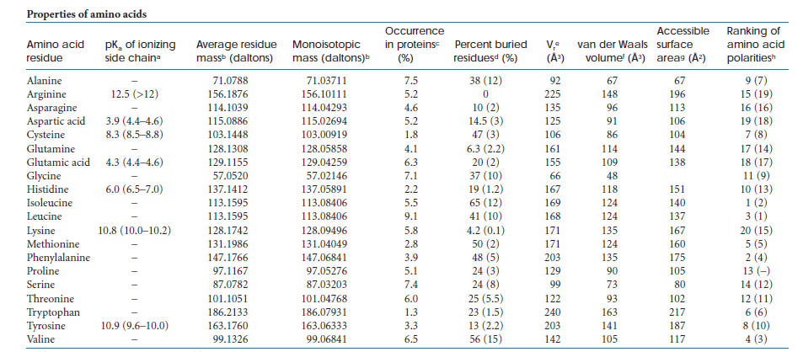
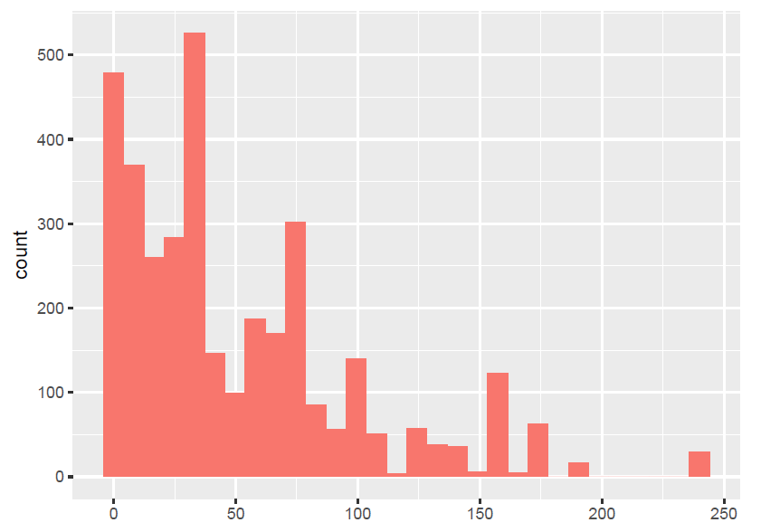
Size Difference
Average volume (Vr) of buried residues, calculated from the surface area of the side chain (Richards 1977; Baumann et al. 1989).

Slide 8
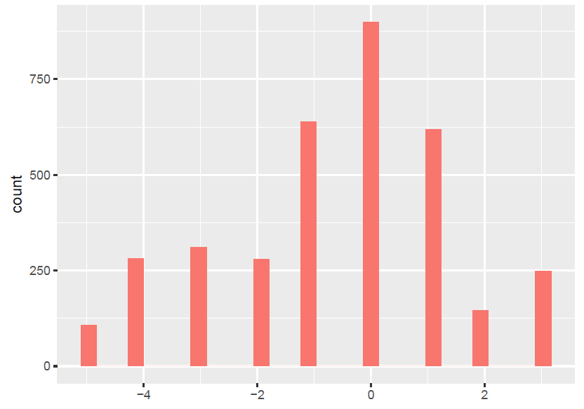
Blosum 90 Histogram

Slide 9
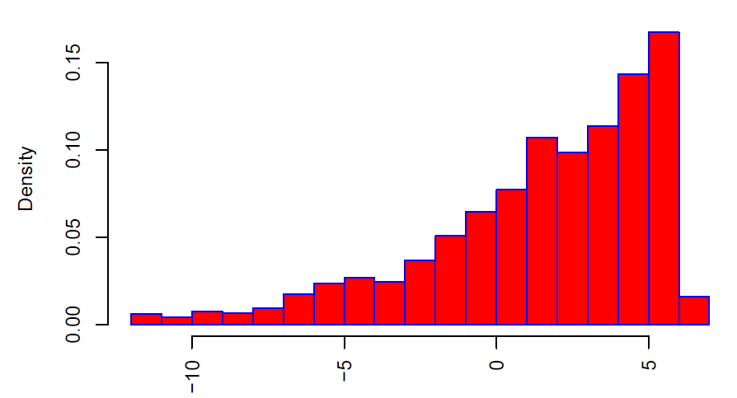
GERP Score Histogram

Slide 10
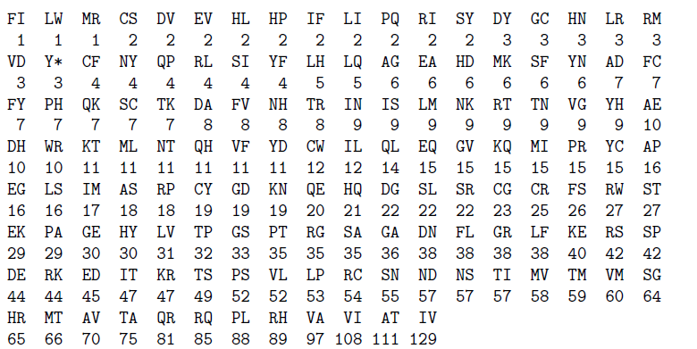
Mutation Frequency

Slide 11
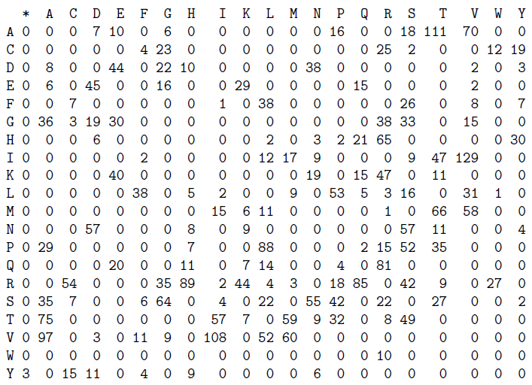
Mutation Frequency (matrix presentation)

Slide 12
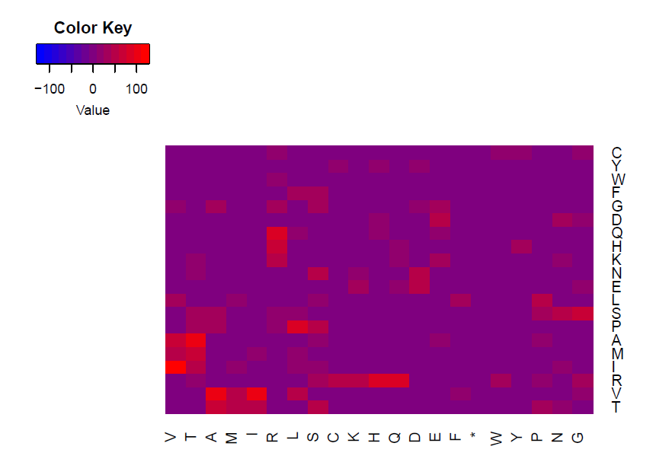
Mutation Frequency (heatmap)

Slide 13


Deleterious Score (DScore)

Slide 14
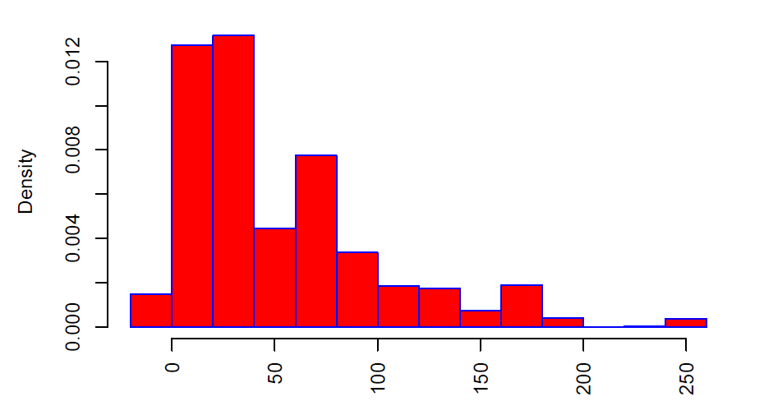
Deleterious Score Histogram

Slide 15
Premature Stop
3 missing nonsense mutations
Length:
1x15
2X101

Slide 16
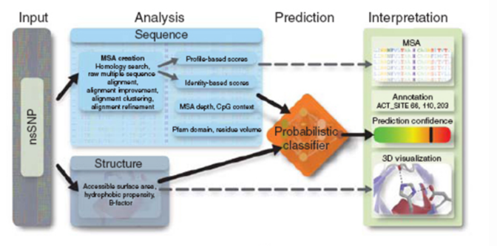

PolyPhen

Slide 17
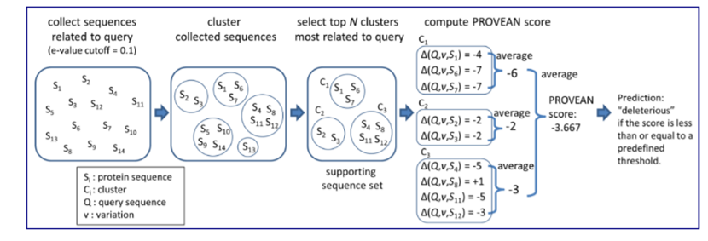

PROVEAN

Slide 18
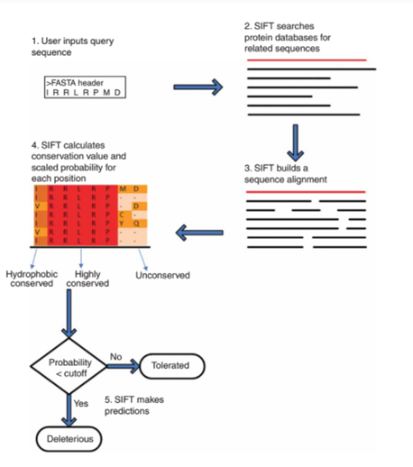

SIFT

Slide 19
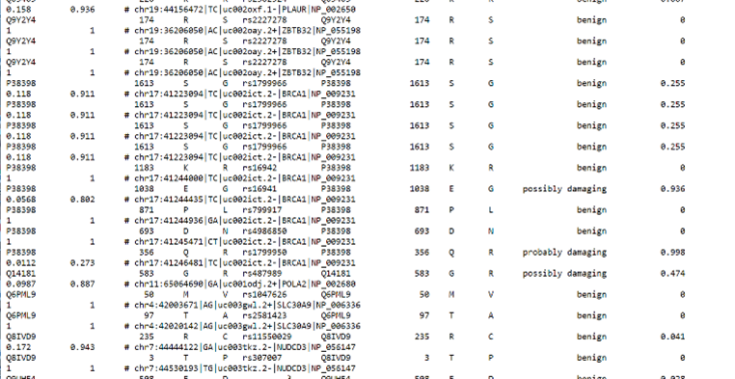


PolyPhen2

Slide 20
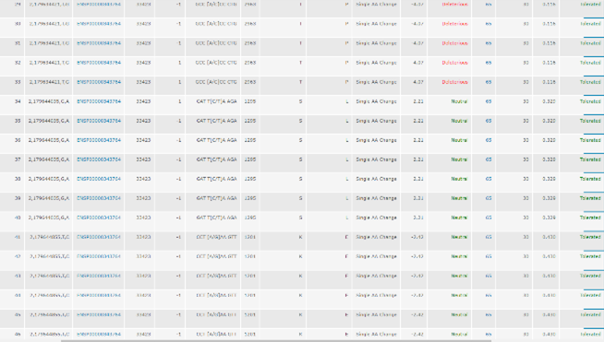
PROVEAN & SIFT

Slide 21
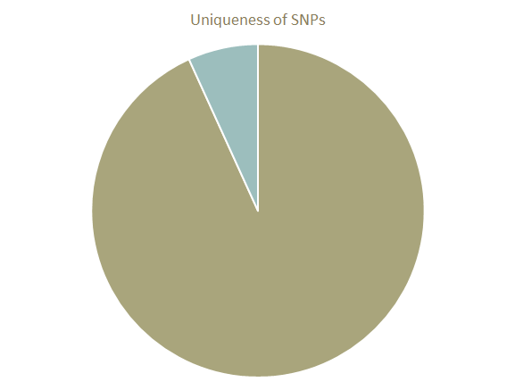

Analyzing the Zimmer Genome

Slide 22
Comparison of Various Programs
 | PolyPhen2 | PROVEAN | SIFT
Benign | 2669 | 3104 | 2851
Possibly Damaging | 293 | 0 | 0
Damaging | 344 | 420 | 658
Undetermined | 0 | 6 | 21
 | PolyPhen2 | PROVEAN | SIFT
Single Amino Acid Change | 3281 | 3514 | 3514
Synonymous | 15 | 10 | 10
Nonsense | 10 | 6 | 6

Slide 23
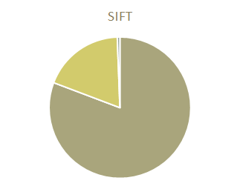
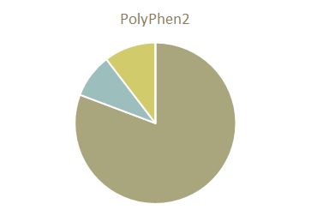
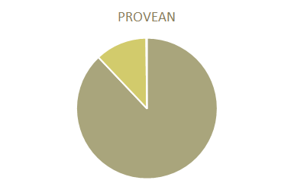
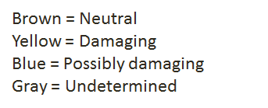
Comparison of Various Programs

Slide 24
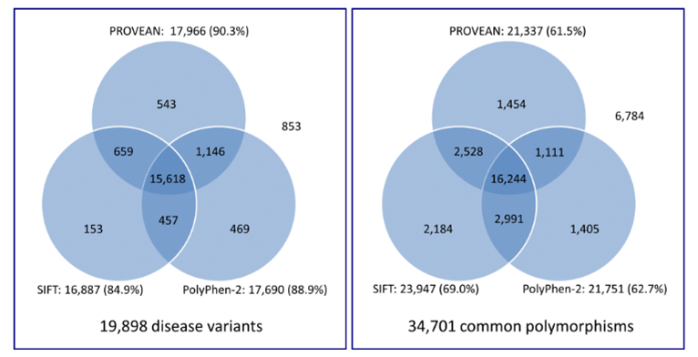

Comparison of Various Programs

